Slide 1

Foundations of Cryptography PRF$↔$PRG, PRP, sPRP, PRF$→$PRP, PRF$→$sPRP, ECB, CBC, OFB
LiangFeng Zhang
zhanglf@shanghaitech.edu.cn
SIST, ShanghaiTech, 2019F

Slide 2




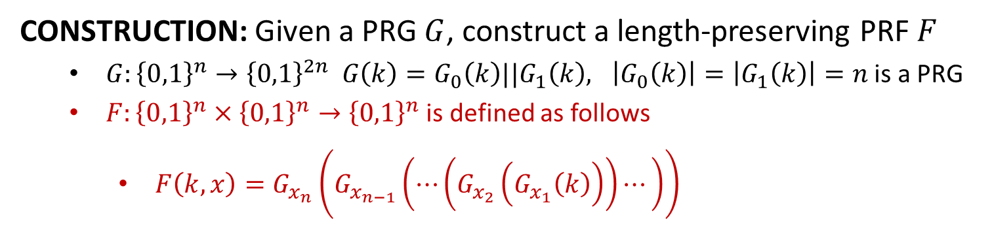






















PRF from PRG
CONSTRUCTION: Given a PRG $G$, construct a length-preserving PRF $F$
$G:{\left\{0,1\right\}}^{n}→{\left\{0,1\right\}}^{2n} G\left(k\right)=G_{0}\left(k\right)||G_{1}\left(k\right), \left|G_{0}\left(k\right)\right|=\left|G_{1}\left(k\right)\right|=n$ is a PRG
$F:{\left\{0,1\right\}}^{n}×{\left\{0,1\right\}}^{n}→{\left\{0,1\right\}}^{n}$ is defined as follows
$F\left(k,x\right)=G_{x_{n}}\left(G_{x_{n−1}}\left(⋯\left(G_{x_{2}}\left(G_{x_{1}}\left(k\right)\right)\right)⋯\right)\right)$
$$n=3$$
$$k$$
$$G_{0}$$
$$G_{1}$$
$$G_{0}(k)$$
$$G_{1}(k)$$
$$G_{0}$$
$$G_{1}$$
$$G_{0}$$
$$G_{1}$$
$$G_{0}$$
$$G_{1}$$
$$G_{0}$$
$$G_{1}$$
$$G_{0}$$
$$G_{1}$$
$$G_{0}$$
$$G_{1}$$
$$F_{k}(000)$$
$$F_{k}(001)$$
$$F_{k}(010)$$
$$F_{k}(011)$$
$$F_{k}(100)$$
$$F_{k}(101)$$
$$F_{k}(110)$$
$$F_{k}(111)$$

Slide 3
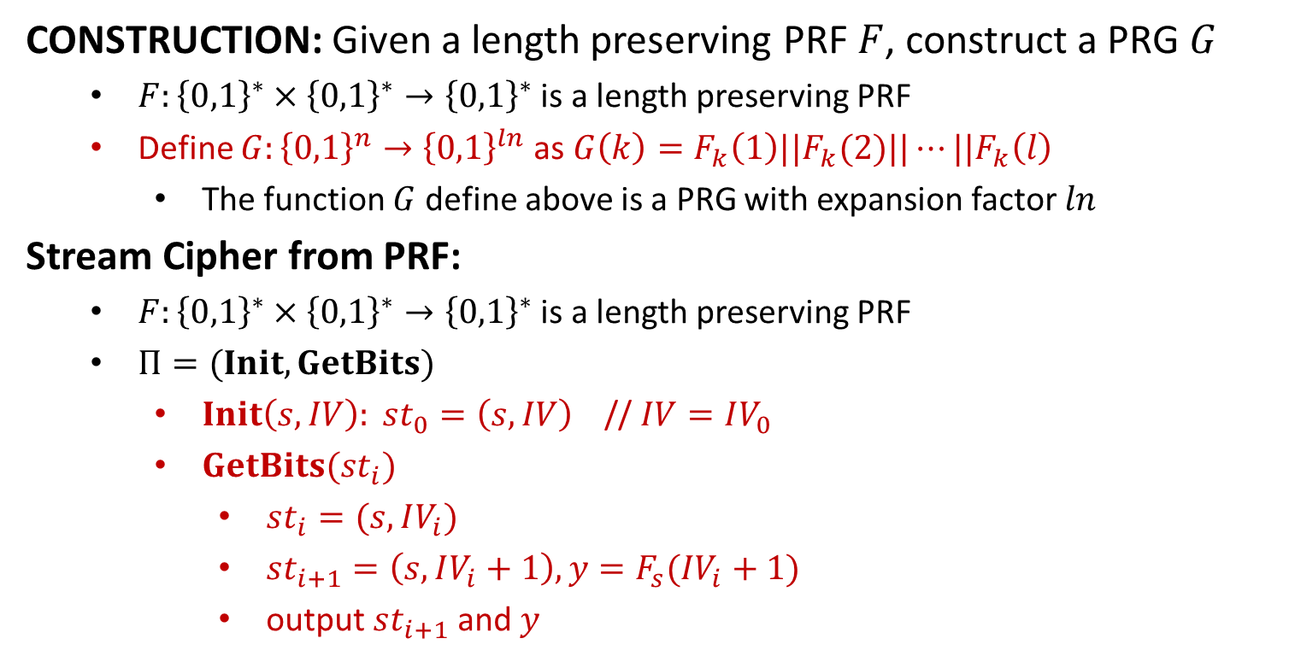
PRG from PRF
CONSTRUCTION: Given a length preserving PRF $F$, construct a PRG $G$
$F:{\left\{0,1\right\}}^{∗}×{\left\{0,1\right\}}^{∗}→{\left\{0,1\right\}}^{∗}$ is a length preserving PRF
Define $G:{\left\{0,1\right\}}^{n}→{\left\{0,1\right\}}^{ln}$ as $G\left(k\right)=F_{k}\left(1\right)||F_{k}(2)||⋯||F_{k}\left(l\right)$
The function $G$ define above is a PRG with expansion factor $ln$
Stream Cipher from PRF:
$F:{\left\{0,1\right\}}^{∗}×{\left\{0,1\right\}}^{∗}→{\left\{0,1\right\}}^{∗}$ is a length preserving PRF
$Π=(Init, GetBits)$
$Init\left(s,IV\right): st_{0}=\left(s,IV\right)$ // $IV=IV_{0}$
$GetBits(st_{i})$
$st_{i}=(s,IV_{i})$
$st_{i+1}=\left(s,IV_{i}+1\right), y=F_{s}(IV_{i}+1)$
output $st_{i+1}$ and $y$

Slide 5
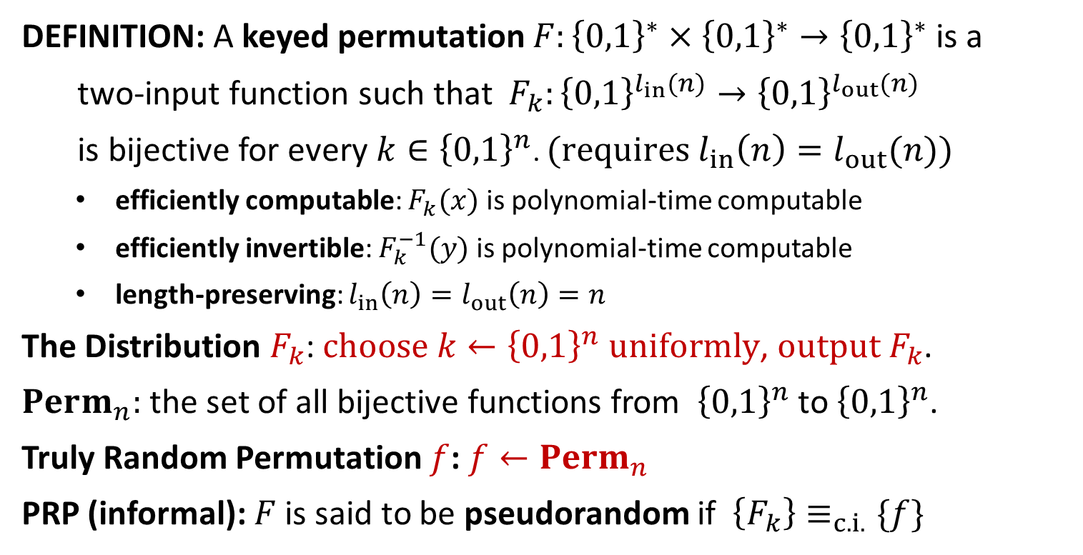
Pseudorandom Permutation (PRP)
DEFINITION: A keyed permutation $F:{\left\{0,1\right\}}^{∗}×{\left\{0,1\right\}}^{∗}→{\left\{0,1\right\}}^{∗}$ is a
two-input function such that $F_{k}:{\left\{0,1\right\}}^{l_{in}(n)}→{\left\{0,1\right\}}^{l_{out}(n)}$
is bijective for every $k∈{\left\{0,1\right\}}^{n}$. $(requires l_{in}\left(n\right)=l_{out}(n))$
efficiently computable: $F_{k}(x)$ is polynomial-time computable
efficiently invertible: $F_{k}^{−1}(y)$ is polynomial-time computable
length-preserving: $l_{in}\left(n\right)=l_{out}\left(n\right)=n$
The Distribution $F_{k}$: $choose k←{\left\{0,1\right\}}^{n} uniformly$, $output F_{k}$.
$Perm_{n}:$ the set of all bijective functions from ${\left\{0,1\right\}}^{n}$ to ${\left\{0,1\right\}}^{n}$.
Truly Random Permutation $f$: $f←Perm_{n}$
PRP (informal): $F$ is said to be pseudorandom if $\left\{F_{k}\right\}≡_{c.i.}\{f\}$

Slide 6

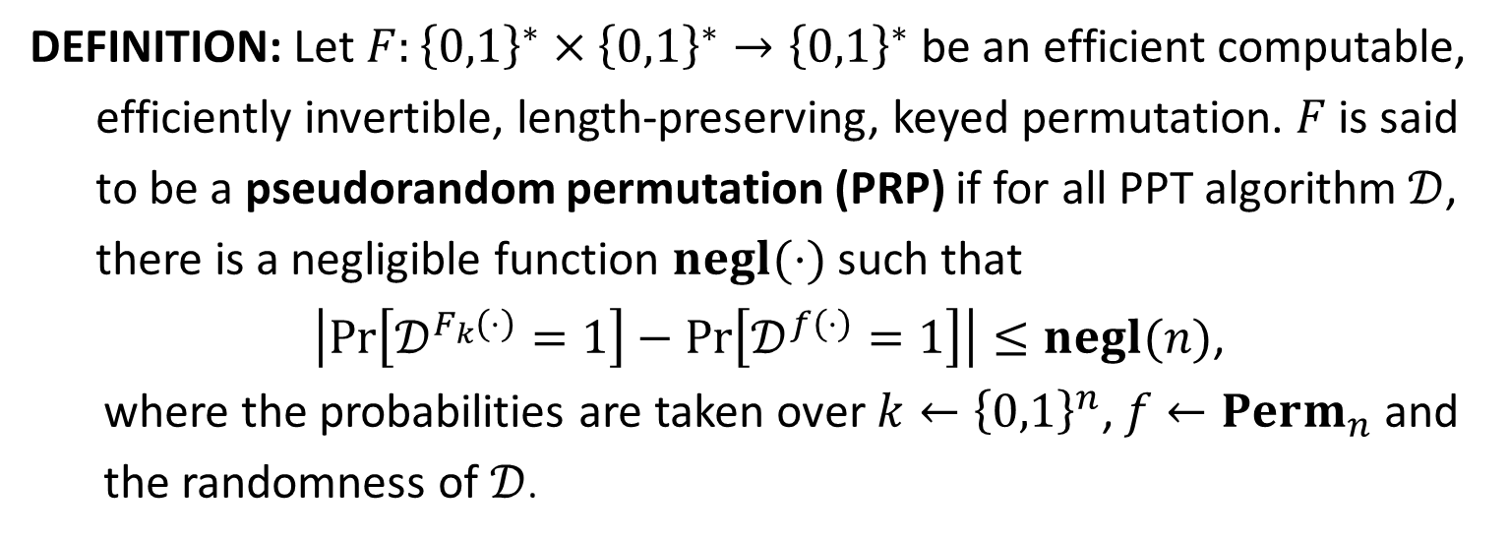


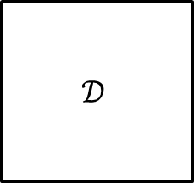
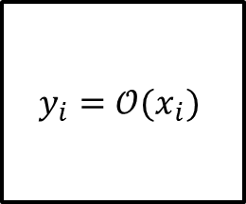

PRP
DEFINITION: Let $F:{\left\{0,1\right\}}^{∗}×{\left\{0,1\right\}}^{∗}→{\left\{0,1\right\}}^{∗}$ be an efficient computable,
efficiently invertible, length-preserving, keyed permutation. $F$ is said
to be a pseudorandom permutation (PRP) if for all PPT algorithm $𝒟$,
there is a negligible function $negl(⋅)$ such that
$\left|\operatorname{Pr}\left[𝒟^{F_{k}\left(⋅\right)}=1\right]−\operatorname{Pr}\left[𝒟^{f\left(⋅\right)}=1\right]\right|≤negl(n)$,
where the probabilities are taken over $k←{\left\{0,1\right\}}^{n}$, $f←Perm_{n}$ and the randomness of $𝒟$.
$$y_{i}=𝒪(x_{i})$$
$$𝒟$$
$$x_{1},x_{2},…,x_{q}$$
$𝒪=F_{k}$ or $f$
$$b$$
$$y_{1},y_{2},…,y_{q}$$
THEOREM: If $F$ is a PRP and $l_{in}\left(n\right)≥n$, then $F$ is a PRF.

Slide 7

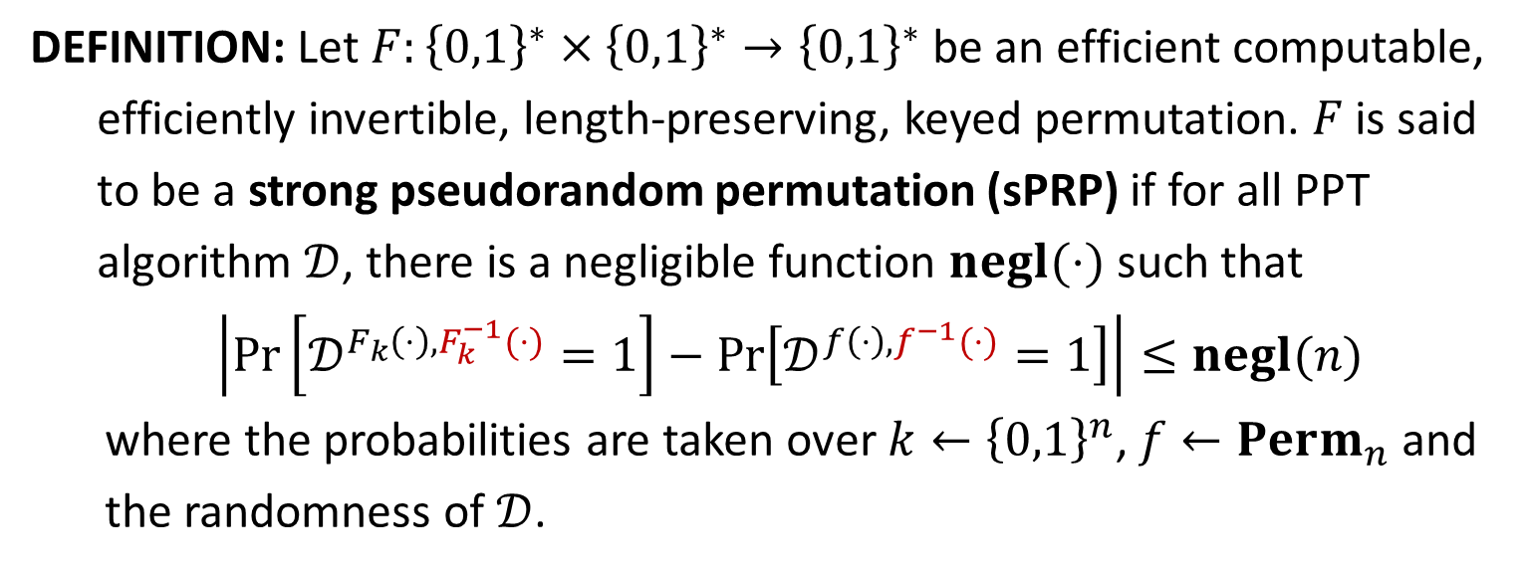




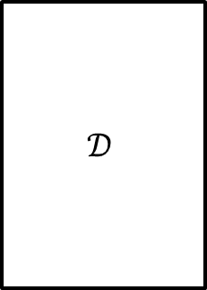
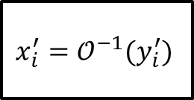
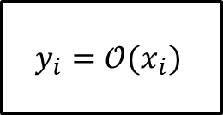

Strong PRP (Block Cipher)
DEFINITION: Let $F:{\left\{0,1\right\}}^{∗}×{\left\{0,1\right\}}^{∗}→{\left\{0,1\right\}}^{∗}$ be an efficient computable,
efficiently invertible, length-preserving, keyed permutation. $F$ is said
to be a strong pseudorandom permutation (sPRP) if for all PPT
algorithm $𝒟$, there is a negligible function $negl(⋅)$ such that
$\left|\operatorname{Pr}\left[𝒟^{F_{k}\left(⋅\right),F_{k}^{−1}(⋅)}=1\right]−\operatorname{Pr}\left[𝒟^{f\left(⋅\right),f^{−1}(⋅)}=1\right]\right|≤negl(n)$
where the probabilities are taken over $k←{\left\{0,1\right\}}^{n}$, $f←Perm_{n}$ and the randomness of $𝒟$.
$$y_{i}=𝒪(x_{i})$$
$$x_{1},x_{2},…,x_{q}$$
$$𝒟$$
$$y_{1},y_{2},…,y_{q}$$
$𝒪=F_{k}$ or $f$
$$b$$
$$x_{i}^{′}=𝒪^{−1}(y_{i}^{′})$$
$$y_{1}^{′},y_{2}^{′},…,y_{q^{′}}^{′}$$
$$x_{1}^{′},x_{2}^{′},…,x_{q^{′}}^{′}$$

Slide 8


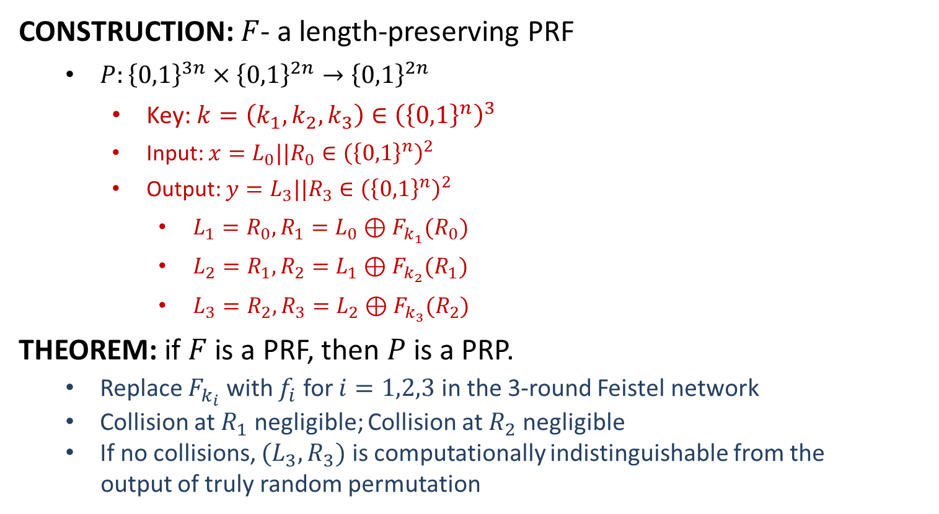












PRP from PRF
CONSTRUCTION: $F$- a length-preserving PRF
$P:{\left\{0,1\right\}}^{3n}×{\left\{0,1\right\}}^{2n}→{\left\{0,1\right\}}^{2n}$
Key: $k=\left(k_{1}, k_{2}, k_{3}\right)∈{\left({\left\{0,1\right\}}^{n}\right)}^{3}$
Input: $x=L_{0}||R_{0}∈{\left({\left\{0,1\right\}}^{n}\right)}^{2}$
Output: $y=L_{3}||R_{3}∈{\left({\left\{0,1\right\}}^{n}\right)}^{2}$
$L_{1}=R_{0}, R_{1}=L_{0}⊕F_{k_{1}}(R_{0})$
$L_{2}=R_{1}, R_{2}=L_{1}⊕F_{k_{2}}(R_{1})$
$L_{3}=R_{2}, R_{3}=L_{2}⊕F_{k_{3}}(R_{2})$
THEOREM: if $F$ is a PRF, then $P$ is a PRP.
Replace $F_{k_{i}}$ with $f_{i}$ for $i=1,2,3$ in the 3-round Feistel network
Collision at $R_{1}$ negligible; Collision at $R_{2}$ negligible
If no collisions, $(L_{3},R_{3})$ is computationally indistinguishable from the
output of truly random permutation
$$L_{0}$$
$$R_{0}$$
$$⨁$$
$$F_{k_{1}}$$
$$L_{1}$$
$$R_{1}$$
$$⨁$$
$$F_{k_{2}}$$
$$L_{2}$$
$$R_{2}$$
$$⨁$$
$$F_{k_{3}}$$
$$L_{3}$$
$$R_{3}$$

Slide 9



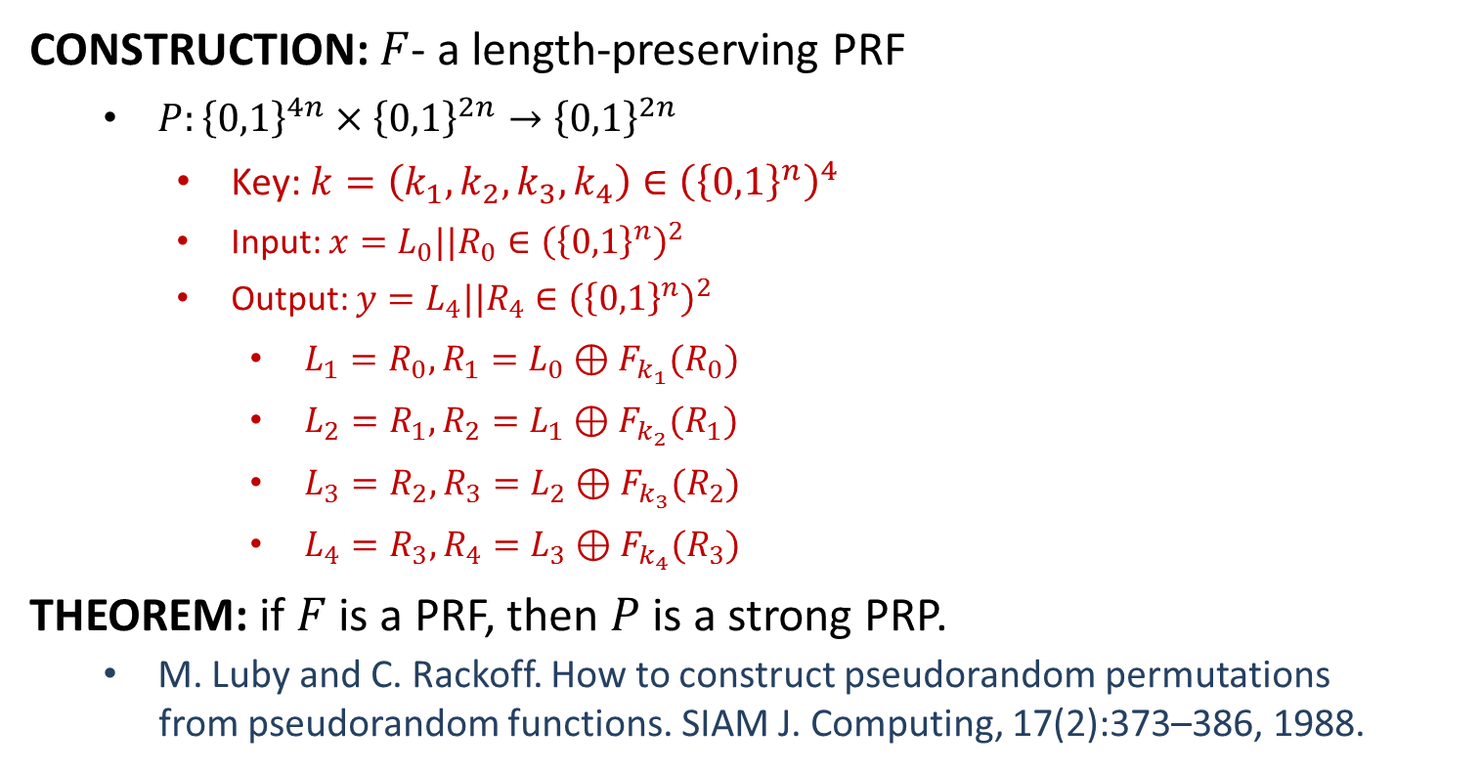















Strong PRP from PRF
CONSTRUCTION: $F$- a length-preserving PRF
$P:{\left\{0,1\right\}}^{4n}×{\left\{0,1\right\}}^{2n}→{\left\{0,1\right\}}^{2n}$
Key: $k=\left(k_{1}, k_{2}, k_{3},k_{4}\right)∈{\left({\left\{0,1\right\}}^{n}\right)}^{4}$
Input: $x=L_{0}||R_{0}∈{\left({\left\{0,1\right\}}^{n}\right)}^{2}$
Output: $y=L_{4}||R_{4}∈{\left({\left\{0,1\right\}}^{n}\right)}^{2}$
$L_{1}=R_{0}, R_{1}=L_{0}⊕F_{k_{1}}(R_{0})$
$L_{2}=R_{1}, R_{2}=L_{1}⊕F_{k_{2}}(R_{1})$
$L_{3}=R_{2}, R_{3}=L_{2}⊕F_{k_{3}}(R_{2})$
$L_{4}=R_{3}, R_{4}=L_{3}⊕F_{k_{4}}(R_{3})$
THEOREM: if $F$ is a PRF, then $P$ is a strong PRP.
M. Luby and C. Rackoff. How to construct pseudorandom permutations
from pseudorandom functions. SIAM J. Computing, 17(2):373–386, 1988.
$$L_{0}$$
$$R_{0}$$
$$⨁$$
$$F_{k_{1}}$$
$$L_{1}$$
$$R_{1}$$
$$⨁$$
$$F_{k_{2}}$$
$$L_{2}$$
$$R_{2}$$
$$⨁$$
$$F_{k_{3}}$$
$$L_{3}$$
$$R_{3}$$
$$⨁$$
$$F_{k_{4}}$$
$$L_{4}$$
$$R_{4}$$

Slide 11
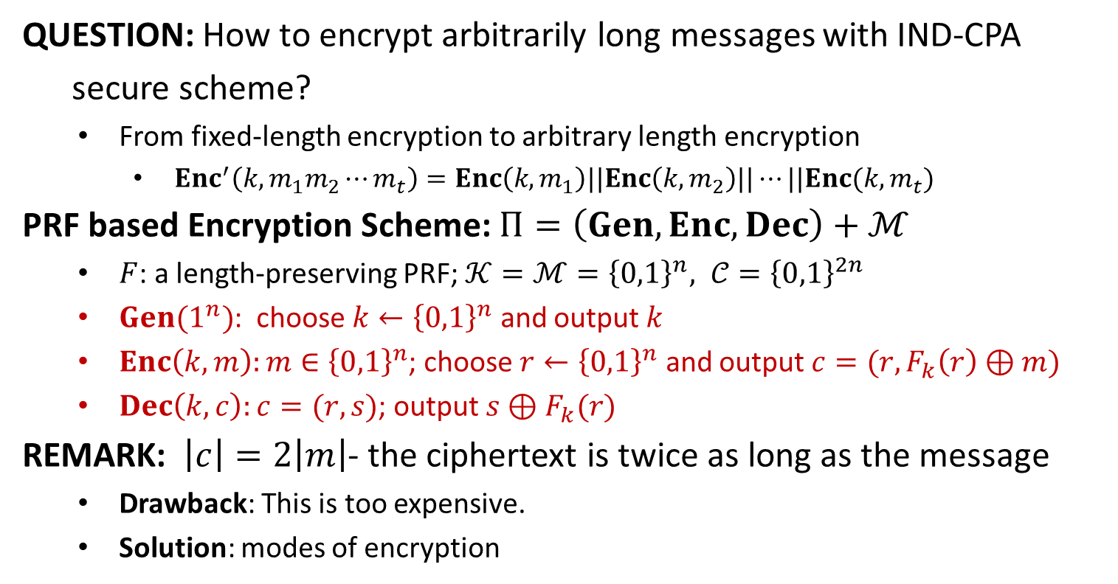
Encrypting More Efficiently
QUESTION: How to encrypt arbitrarily long messages with IND-CPA
secure scheme?
From fixed-length encryption to arbitrary length encryption
$Enc^{′}\left(k,m_{1}m_{2}⋯m_{t}\right)=Enc\left(k,m_{1}\right)||Enc\left(k,m_{2}\right)||⋯||Enc(k,m_{t})$
PRF based Encryption Scheme: $Π=\left(Gen,Enc, Dec\right)+ℳ$
$F$: a length-preserving PRF; $𝒦=ℳ={\left\{0,1\right\}}^{n}, 𝒞={\left\{0,1\right\}}^{2n}$
$Gen(1^{n})$: choose $k←{\left\{0,1\right\}}^{n}$ and output $k$
$Enc\left(k,m\right):m∈{\left\{0,1\right\}}^{n}$; choose $r←{\left\{0,1\right\}}^{n}$ and output $c=(r,F_{k}\left(r\right)⊕m)$
$Dec\left(k,c\right):c=(r,s)$; output $s⊕F_{k}(r)$
REMARK: $\left|c\right|=2\left|m\right|$- the ciphertext is twice as long as the message
Drawback: This is too expensive.
Solution: modes of encryption

Slide 12
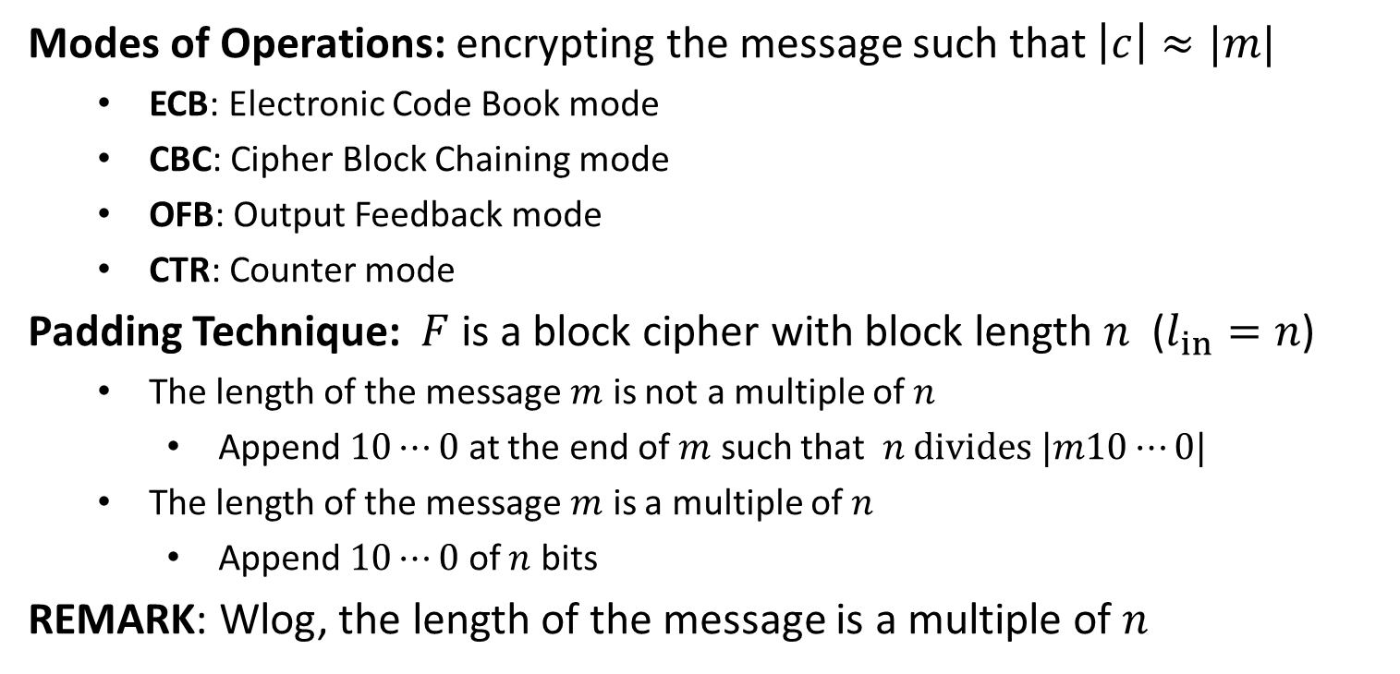
Modes of Operation
Modes of Operations: encrypting the message such that $\left|c\right|≈|m|$
ECB: Electronic Code Book mode
CBC: Cipher Block Chaining mode
OFB: Output Feedback mode
CTR: Counter mode
Padding Technique: $F$ is a block cipher with block length $n$ ($l_{in}=n$)
The length of the message $m$ is not a multiple of $n$
Append $10⋯0$ at the end of $m$ such that $n divides |m10⋯0|$
The length of the message $m$ is a multiple of $n$
Append $10⋯0$ of $n$ bits
REMARK: Wlog, the length of the message is a multiple of $n$

Slide 14

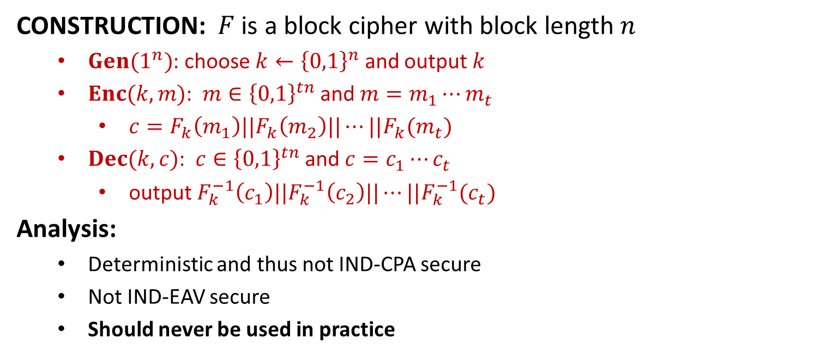







ECB
CONSTRUCTION: $F$ is a block cipher with block length $n$
$Gen(1^{n})$: choose $k←{\left\{0,1\right\}}^{n}$ and output $k$
$Enc(k,m)$: $m∈{\left\{0,1\right\}}^{tn}$ and $m=m_{1}⋯m_{t}$
$c=F_{k}\left(m_{1}\right)||F_{k}\left(m_{2}\right)||⋯||F_{k}(m_{t})$
$Dec(k,c)$: $c∈{\left\{0,1\right\}}^{tn}$ and $c=c_{1}⋯c_{t}$
output $F_{k}^{−1}\left(c_{1}\right)||F_{k}^{−1}\left(c_{2}\right)||⋯||F_{k}^{−1}(c_{t})$
Analysis:
Deterministic and thus not IND-CPA secure
Not IND-EAV secure
Should never be used in practice
$$m_{1}$$
$$m_{2}$$
$$m_{3}$$
$$F_{k}$$
$$F_{k}$$
$$F_{k}$$
$$c_{1}$$
$$c_{2}$$
$$c_{3}$$

Slide 15


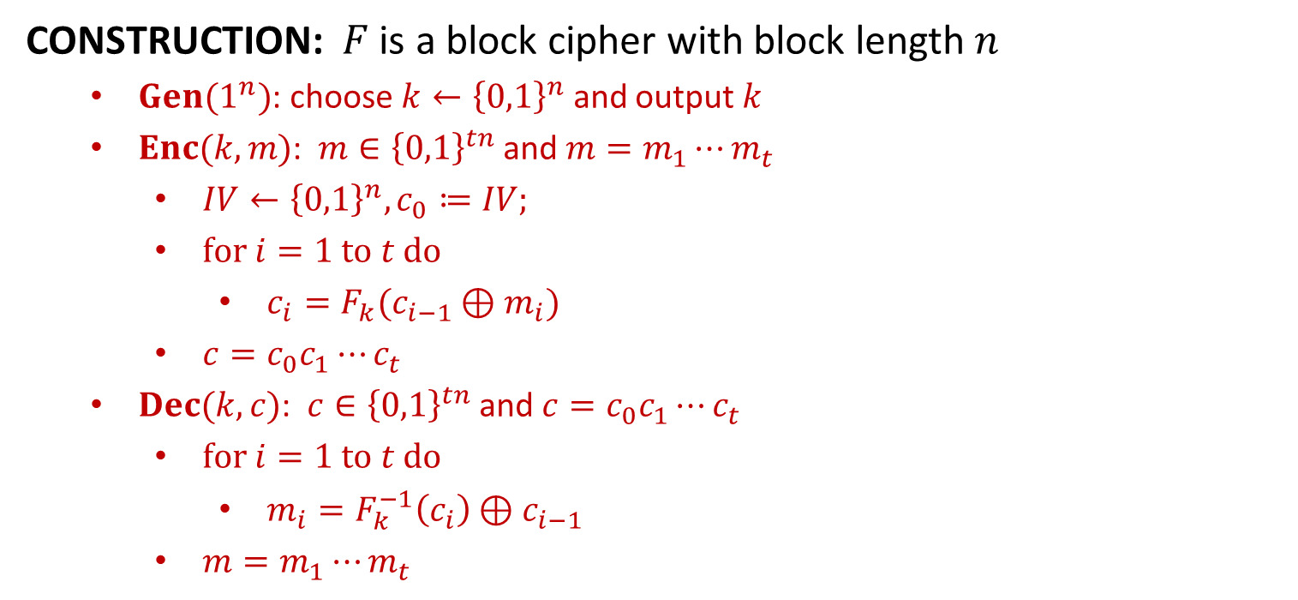






CBC
CONSTRUCTION: $F$ is a block cipher with block length $n$
$Gen(1^{n})$: choose $k←{\left\{0,1\right\}}^{n}$ and output $k$
$Enc(k,m)$: $m∈{\left\{0,1\right\}}^{tn}$ and $m=m_{1}⋯m_{t}$
$IV←{\left\{0,1\right\}}^{n}, c_{0}≔IV;$
$for i=1 to t do$
$c_{i}=F_{k}(c_{i−1}⊕m_{i})$
$c=c_{0}c_{1}⋯c_{t}$
$Dec(k,c)$: $c∈{\left\{0,1\right\}}^{tn}$ and $c=c_{0}c_{1}⋯c_{t}$
$for i=1 to t do$
$m_{i}=F_{k}^{−1}\left(c_{i}\right)⊕c_{i−1}$
$m=m_{1}⋯m_{t}$
$$m_{1}$$
$$m_{2}$$
$$m_{3}$$
$$IV$$
$$⨁$$
$$⨁$$
$$⨁$$
$$F_{k}$$
$$F_{k}$$
$$F_{k}$$
$$IV$$
$$c_{1}$$
$$c_{2}$$
$$c_{3}$$

Slide 16
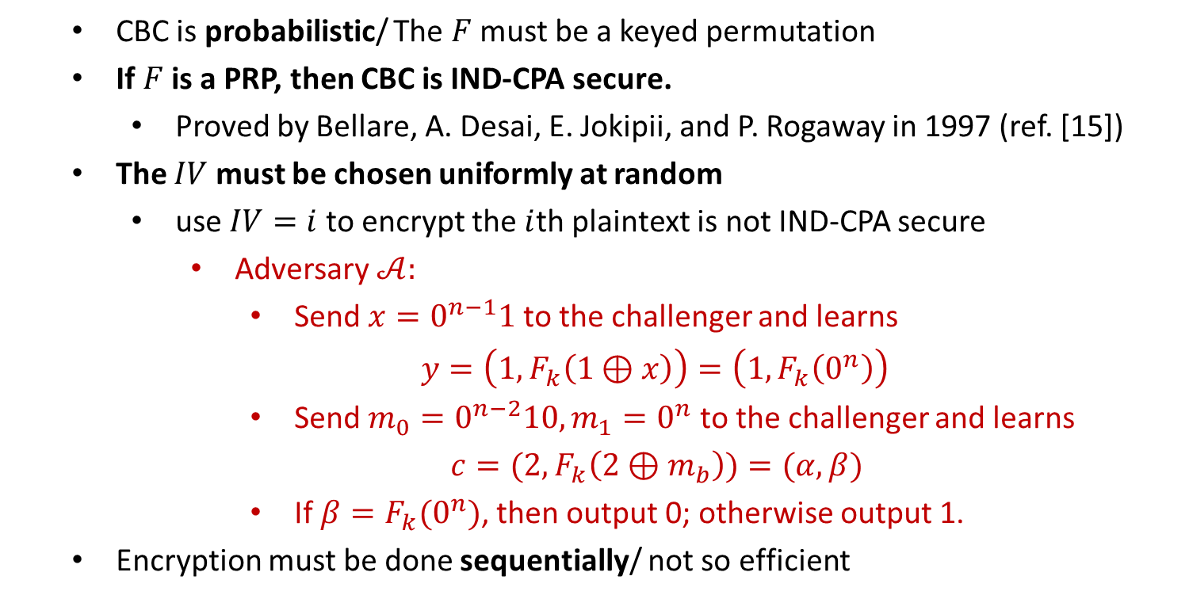
CBC
CBC is probabilistic/ The $F$ must be a keyed permutation
If $F$ is a PRP, then CBC is IND-CPA secure.
Proved by Bellare, A. Desai, E. Jokipii, and P. Rogaway in 1997 (ref. [15])
The $IV$ must be chosen uniformly at random
use $IV=i$ to encrypt the $i$th plaintext is not IND-CPA secure
Adversary $𝒜:$
Send $x=0^{n−1}1$ to the challenger and learns
$y=\left(1,F_{k}\left(1⊕x\right)\right)=\left(1,F_{k}\left(0^{n}\right)\right)$
Send $m_{0}=0^{n−2}10, m_{1}=0^{n}$ to the challenger and learns
$c=(2,F_{k}\left(2⊕m_{b}\right))=(α, β)$
If $β=F_{k}(0^{n})$, then output 0; otherwise output 1.
Encryption must be done sequentially/ not so efficient

Slide 17
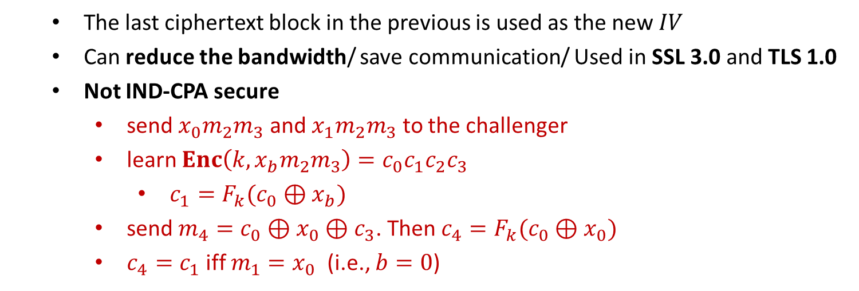
Chained CBC
The last ciphertext block in the previous is used as the new $IV$
Can reduce the bandwidth/ save communication/ Used in SSL 3.0 and TLS 1.0
Not IND-CPA secure
send $x_{0}m_{2}m_{3}$ and $x_{1}m_{2}m_{3}$ to the challenger
learn $Enc\left(k,x_{b}m_{2}m_{3}\right)=c_{0}c_{1}c_{2}c_{3}$
$c_{1}=F_{k}(c_{0}⊕x_{b})$
send $m_{4}=c_{0}⊕x_{0}⊕c_{3}$. Then $c_{4}=F_{k}(c_{0}⊕x_{0})$
$c_{4}=c_{1}$ iff $m_{1}=x_{0}$ (i.e., $b=0$)

Slide 18


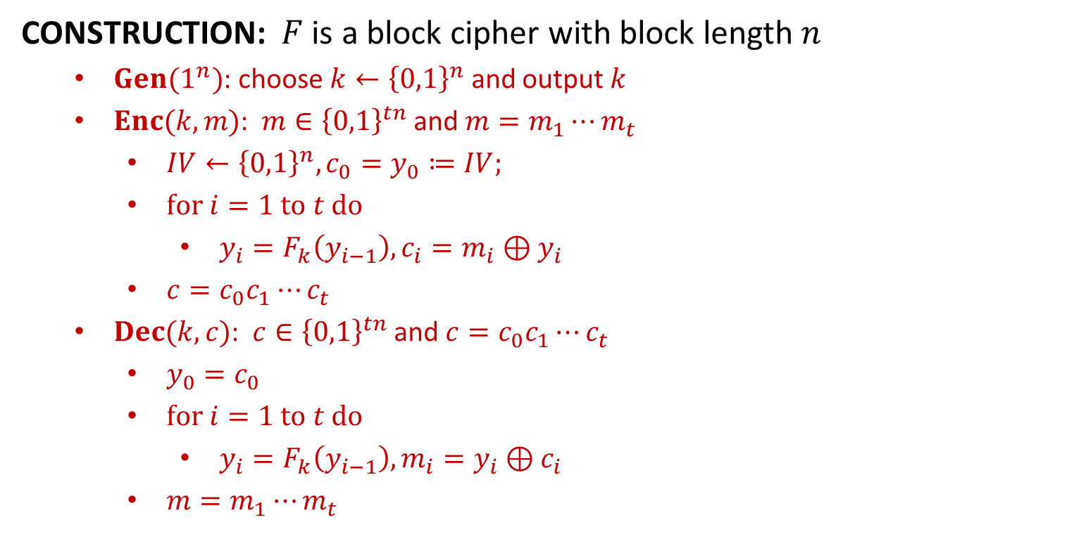











OFB
CONSTRUCTION: $F$ is a block cipher with block length $n$
$Gen(1^{n})$: choose $k←{\left\{0,1\right\}}^{n}$ and output $k$
$Enc(k,m)$: $m∈{\left\{0,1\right\}}^{tn}$ and $m=m_{1}⋯m_{t}$
$IV←{\left\{0,1\right\}}^{n}, {c_{0}=y}_{0}≔IV;$
$for i=1 to t do$
$y_{i}=F_{k}\left(y_{i−1}\right), c_{i}=m_{i}⊕y_{i}$
$c=c_{0}c_{1}⋯c_{t}$
$Dec(k,c)$: $c∈{\left\{0,1\right\}}^{tn}$ and $c=c_{0}c_{1}⋯c_{t}$
$y_{0}=c_{0}$
$for i=1 to t do$
$y_{i}=F_{k}\left(y_{i−1}\right), m_{i}=y_{i}⊕c_{i}$
$m=m_{1}⋯m_{t}$
$$IV$$
$$F_{k}$$
$$F_{k}$$
$$F_{k}$$
$$m_{1}$$
$$⨁$$
$$m_{2}$$
$$⨁$$
$$m_{3}$$
$$⨁$$
$$IV$$
$$c_{1}$$
$$c_{2}$$
$$c_{3}$$

Slide 19
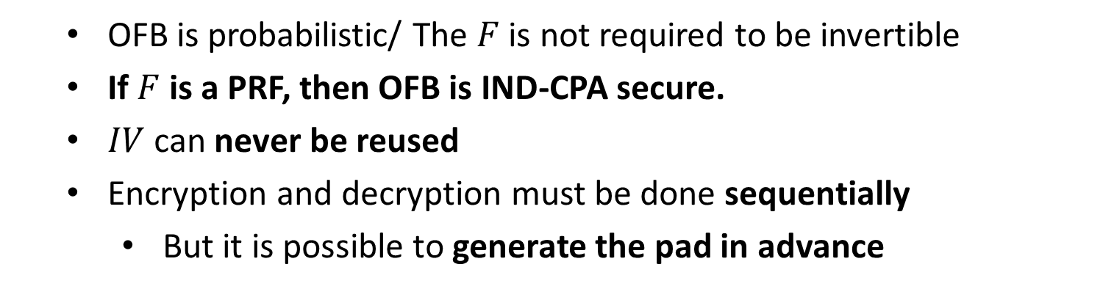
OFB
OFB is probabilistic/ The $F$ is not required to be invertible
If $F$ is a PRF, then OFB is IND-CPA secure.
$IV$ can never be reused
Encryption and decryption must be done sequentially
But it is possible to generate the pad in advance

